Slide 1
COURSE ELECTIVE DAY 2021
RHS CHOIRS

Slide 2
RICHMOND HIGH SCHOOL CHOIRS
CONCERT CHOIR
WOMEN’S CHORALE
MEN’S ENSEMBLE

Slide 3
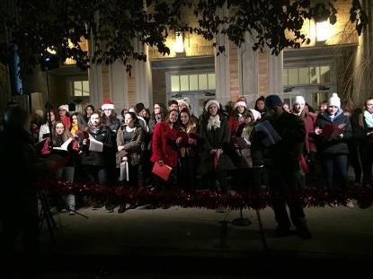
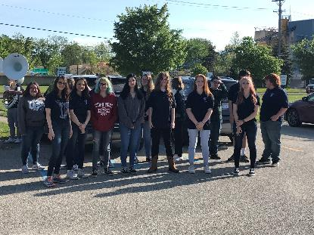
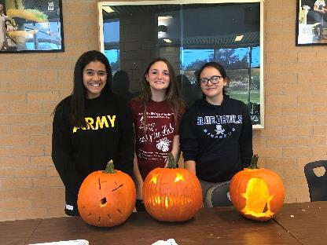
CONCERT CHOIR
1.0 CREDIT-FULL YEAR COURSE
PREREQUISITES: NONE
GRADE LEVEL: 9TH-12TH GRADE
MIXED ENSEMBLE

Slide 4
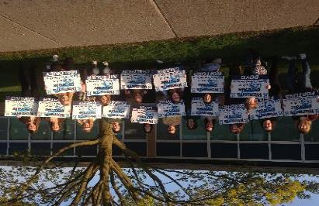
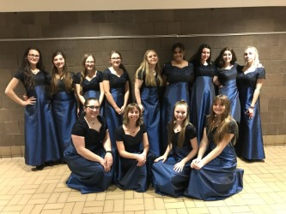
WOMEN’S CHORALE
HONOR’S LEVEL COURSE
1.0 CREDIT-FULL YEAR COURSE
PREREQUISITES: AUDITION ONLY (March)
GRADE LEVEL: 9TH-12TH GRADE
WOMEN’S ENSEMBLE
ZERO HOUR (MEETS 6:40-7:30 EVERY DAY)

Slide 5
MEN’S ENSEMBLE
NO CREDIT-EXTRA CURRICULAR ENSEMBLE
GRADE LEVEL:9TH-12TH GRADE
MEETS AFTER SCHOOL ONCE A WEEK
PERFORMS AT SEVERAL CONCERTS THROUGHOUT THE YEAR.
JULETIDE CONCERT
ENRICHMOND
SPRING CONCERT

Slide 6
WHAT CAN I EXPECT IN A CHOIR CLASS?
SINGING A VARIETY OF STYLES OF MUSIC
PERFORMANCES DURING AND AFTER SCHOOL
PROPER VOCAL TECHNIQUE
WARM-UPS (SOMETIMES EVEN A LITTLE SILLY)
READING MUSIC
PERFORMING THROUGHOUT THE COMMUNITY
FIELD TRIPS (Day and Overnight)
CHOIR (TEAM BUILDING) FUN!

Slide 7
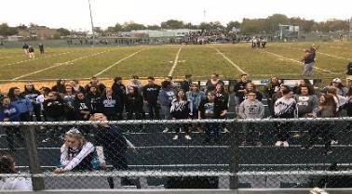
CONCERT PERFORMANCES
HOMECOMING
VETERAN’S DAY CONCERT
FALL/HALLOWEEN CONCERT
JULETIDE HOLIDAY CONCERT
Solo & Ensemble (optional)
CHORAL FESTIVAL (DISTRICT AND STATE LEVELS)
ENRICHMOND FINE ARTS NIGHT
SPRING CONCERTS (Pop, Broadway, Disney, Richmond Idol, Decades, etc.)
GRADUATION

Slide 8
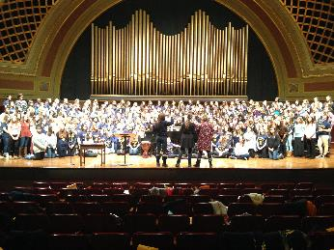
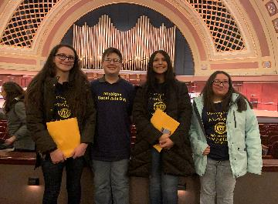
FIELD TRIPS/TEAM BUILDING
FIELD TRIPS
Oakland University
University of Michigan
Fox/Fischer Theatre
CJ Barrymore’s
THE YOUNG AMERICANS!!!!

Slide 9
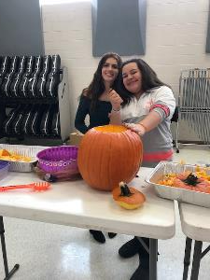
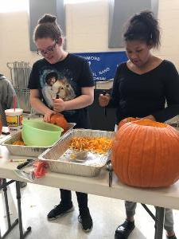
FIELD TRIPS/TEAM BUILDING
TEAM BUILDING
CHOIR BBQ (September/June)
Pumpkin Carving (October)
Caroling at the Richmond Tree Lighting (December)
Breakfast!!
Secret Santa

Slide 10
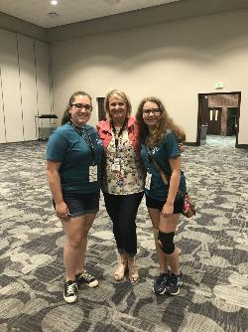
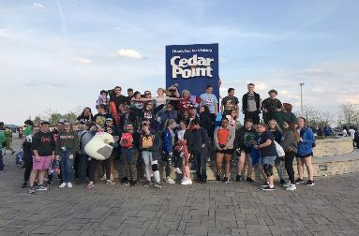
TRAVELING AND TEAM BUILDING
TRAVEL
Port Huron (Leadership Conference)
CEDAR POINT
NASHVILLE
CHICAGO (Fall??)

Slide 11
Doesn’t Choir Conflict with other Events??
In short, NO!!!
Sports and Choir-
Cheer, Basketball, Volleyball, Cross Country
We Work Together with Coaches!
Co/Extracurricular Activities and Choir-
Band, Dance, Work, Gymnastics, Etc.
Academics and Choir-
Honor’s Classes, AP, Homework!

Slide 12
WHY CHOIR??
“I LOVE TO SING!”
“I have a PASSION for MUSIC!”
“To become a BETTER SINGER and IMPROVE MY SINGING VOICE”
“You are able to choose choir because you WANT to be HERE, not because you HAVE to be here”
“You get to see your PROGRESS along the journey of learning a song…beginning, middle, and end.”
“Being able to be a part of something that you love and do it with your FRIENDS”
“WE have FUN singing KARAOKE and playing GAMES!”
“I love to PERFORM on stage! I am a dancer and singer”
“BONUS: Women’s Chorale is an Honor’s level Course!”
“We do FUN things! Trips, Team Building, Senior Breakfast, Secret Santa, Carving Pumpkins”
“Women’s Chorale is before school. You can take other classes that doesn’t interfere with your in school classwork”.
“We get to sing all different types of music”.
“ I’ve been in choir since 6th Grade. Why stop now?!”
“ Choir counts as a Fine Arts Credit”
“ A place to create FRIENDSHIPS”
“We are a CHOIR FAMILY!!!”

Slide 13
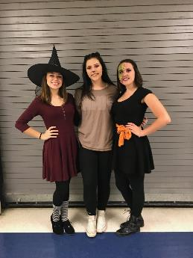
I WANT TO BE IN CHOIR, NOW WHAT?
Bring a Friend
AND:
SIGN UP
FOR
CHOIR!
SEE YOU NEXT YEAR!
AUDITION
FOR
WOMEN’S CHORALE!

