Slide 1
COURSE ELECTIVE DAY 2021
MUSIC ELECTIVES

Slide 2
COURSE ELECTIVE DAY 2021
HISTORY OF AMERICAN MUSIC
(a.k.a History of Rock ‘n’ Roll)

Slide 3
HISTORY OF AMERICAN MUSIC
0.5 CREDIT-1 SEMESTER COURSE
PREREQUISITES: NONE.
GRADE LEVEL:9TH-12TH GRADE

Slide 4
HISTORY OF AMERICAN MUSIC What to Expect in Class
Learn an appreciation for all genres of music.
Video and Listening examples of various genres of music.
Learn through various modes of Technology.
Gain historical perspective of music and it’s timeline.

Slide 5
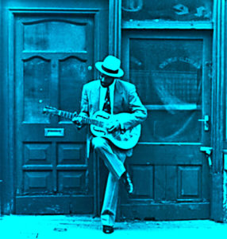
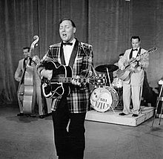
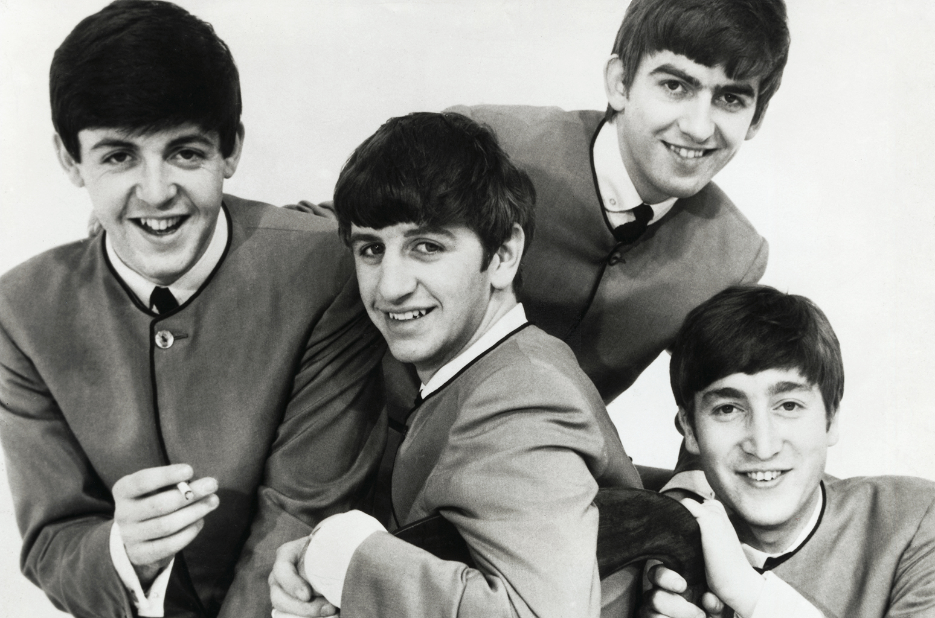
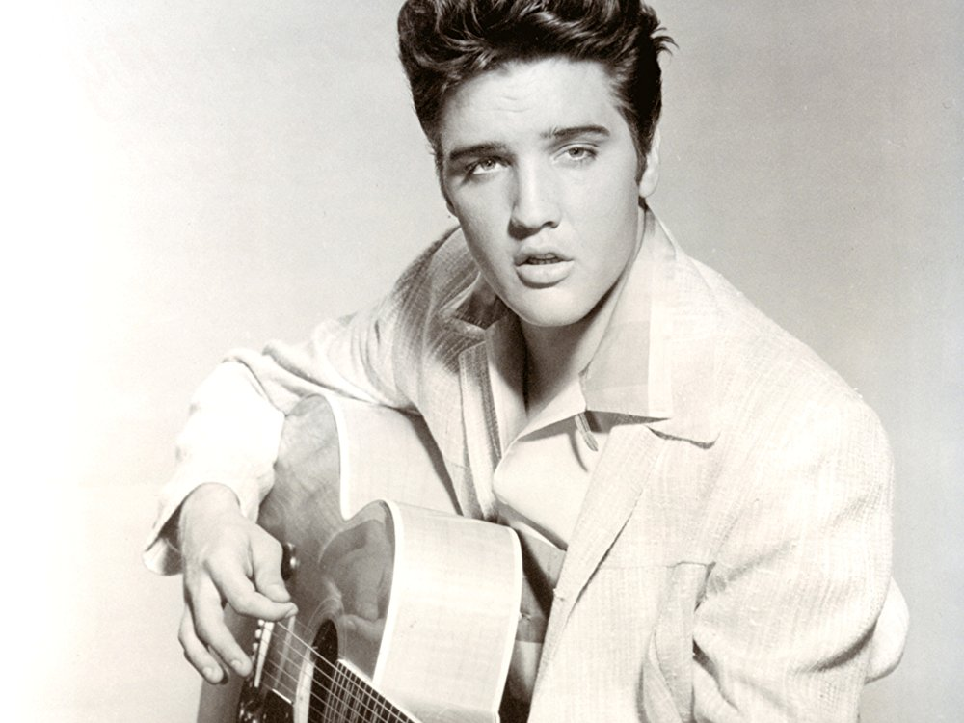
HISTORY OF AMERICAN MUSIC
1900’s Blues
British Invasion
1950’s Rockabilly
Early Rock Stars

Slide 6
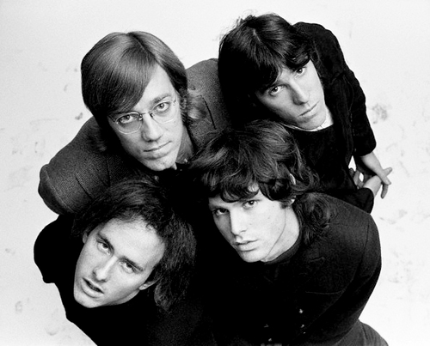
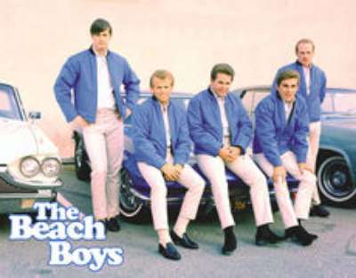
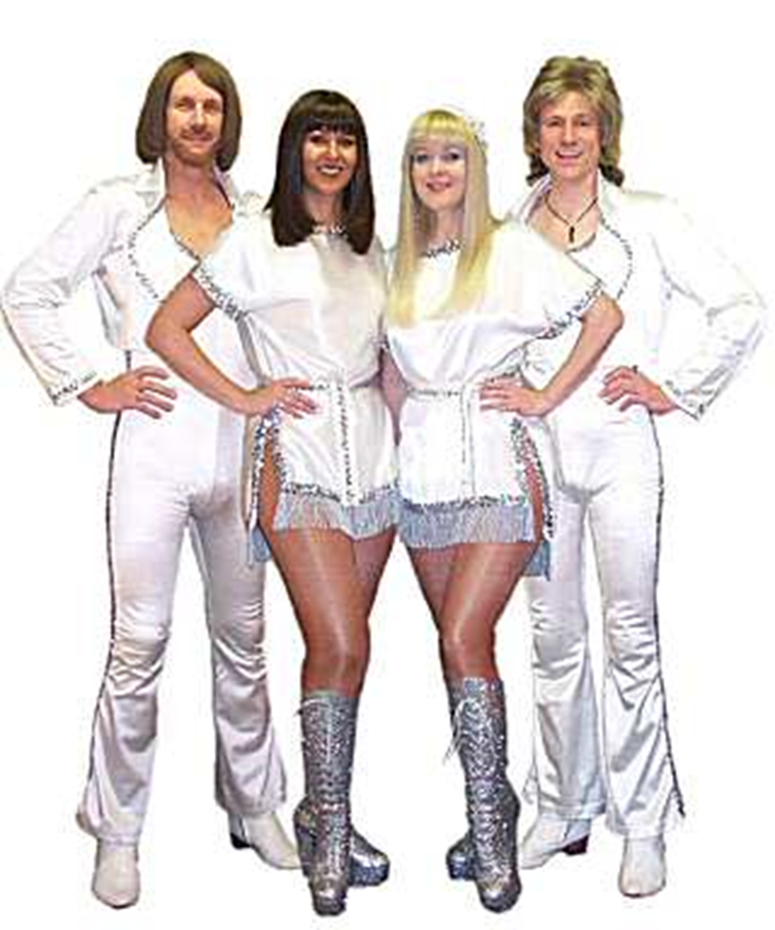
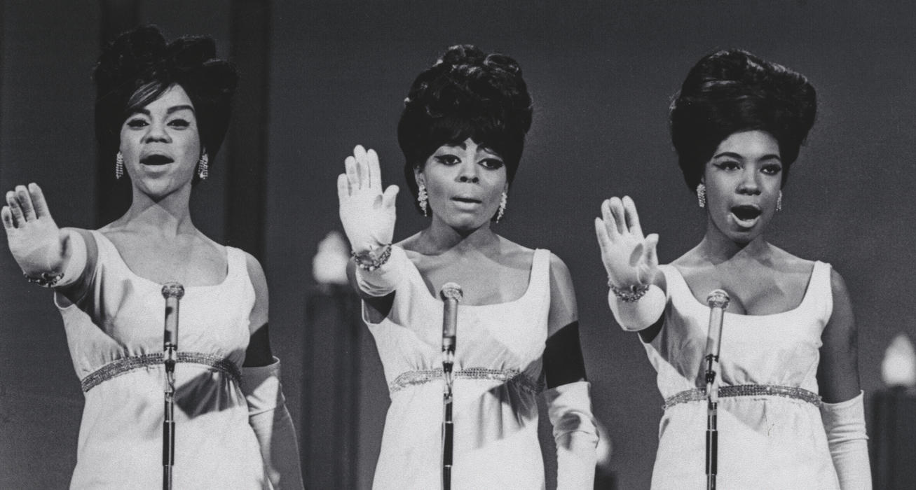
HISTORY OF AMERICAN MUSIC
60’s/70’s Rock
Surf
Motown/Soul
Disco

Slide 7
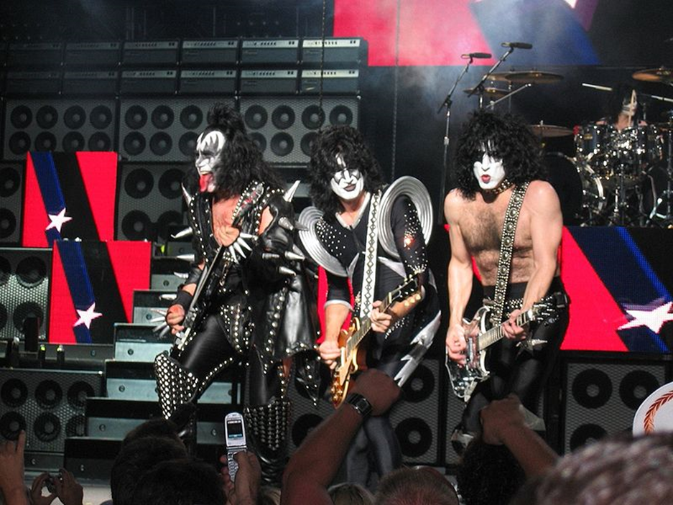
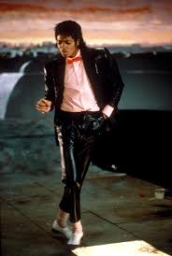
HISTORY OF AMERICAN MUSIC
Progressive
80’s Pop
8o’s Hair Bands

