Slide 1
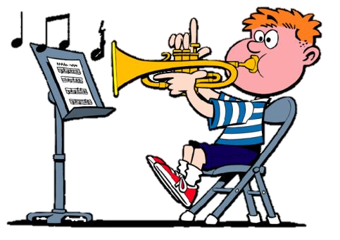
How to practice …..and get better!
Molly Schack
Richmond community Schools
Instrumental music

Slide 2
Who played it better?
If playing should get better over time, why does an 11 year old play better then a 17 year old?
Can you improve with practice?

Slide 3
Programming the brain
“Practice Makes Perfect”
PERFECT practice makes perfect
Brain Plasticity
Learning occurs one time. After that it is reinforcement
Repetition is CRUITIAL to neuronal development.
Use it or loose it!

Slide 4
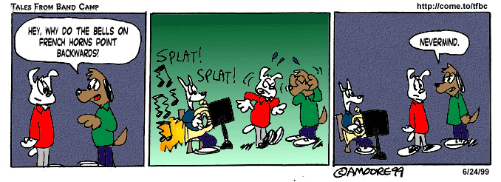
10 practice tips
10. Set-up in an area so you will not be interrupted or distracted.
No television, computer, phone, etc.
No loud or distracting noises.
No younger brothers or sisters.

Slide 5
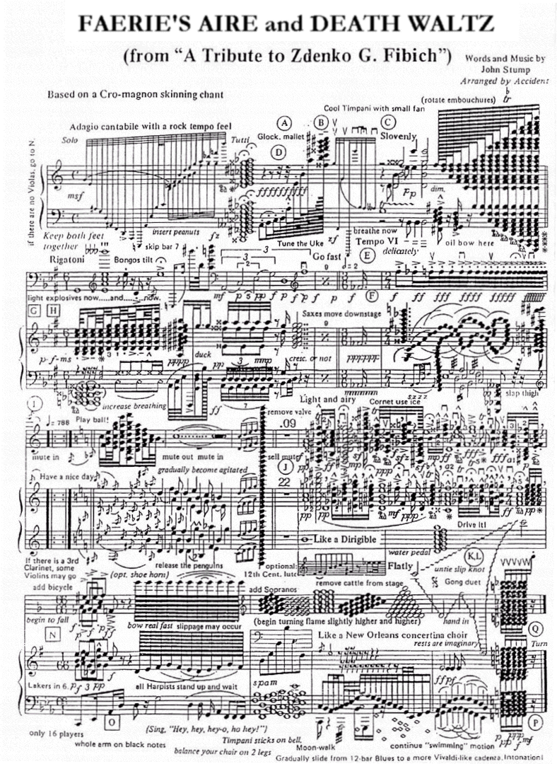
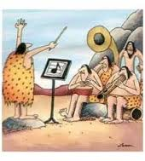
10 practice tips
9. Select appropriate repertoire
Play something from:
The Past (5 min)
The Present (10 min)
The Future (5 min)

Slide 6
10 practice tips
8. Start at the end and work backward in sections.
Save the stuff you know for the every end.
After a warm up, start with something you don’t know.
Begin with the most challenging, hardest spot in the music while your fresh.

Slide 7
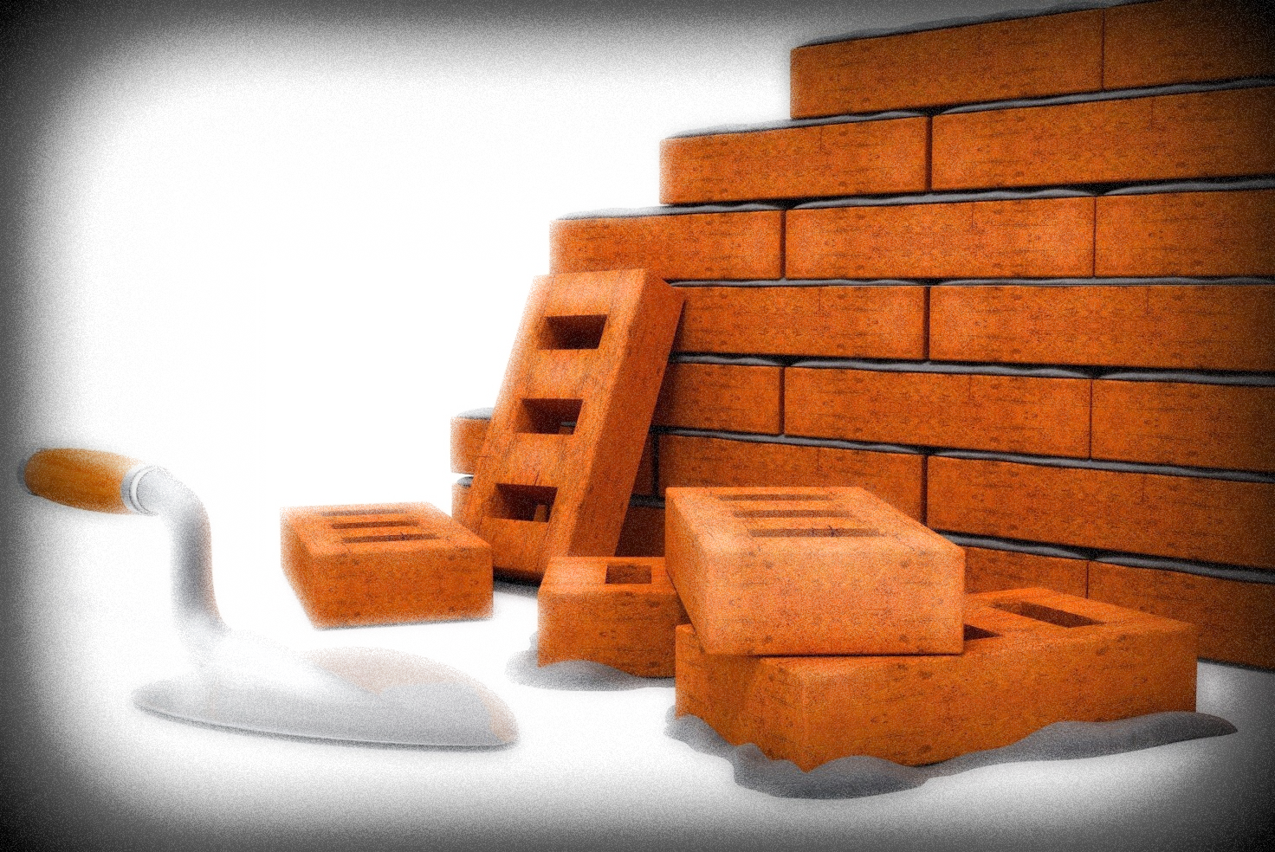
10 practice tips
7. Work on one element at a time.
Rhythm….Count and clap. Write in counts.
Note names….say the note names.
Fingerings…..Say the notes or count the rhythms and push down the correct fingers.
Musical elements (phrasing, dynamics, articulations)

Slide 8
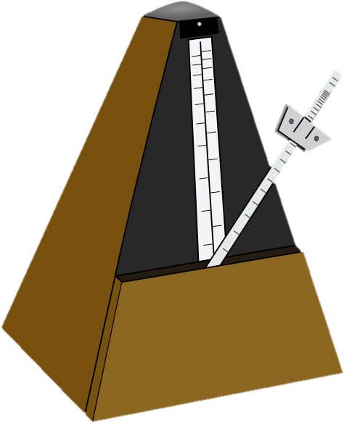
10 practice tips
6. Practice difficult sections SLOWLY
Perform each section perfectly 3 times, then increase the tempo.
Focus on a few (or one) measure at a time.
Always play to the next down beat or beat 1.

Slide 9
10 practice tips
5. Take a break.
Practice in short, focused durations.
15 minutes/4 days a week is better then 60 minutes all at once.
Remember, programing the brain takes repetition and time.

Slide 10
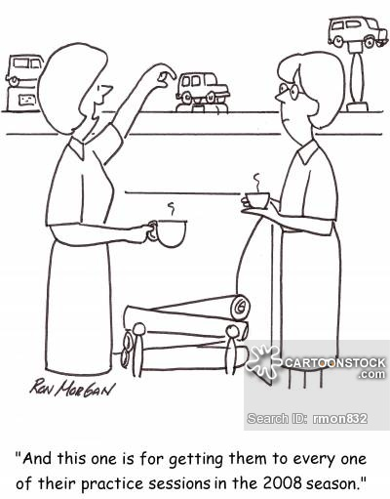
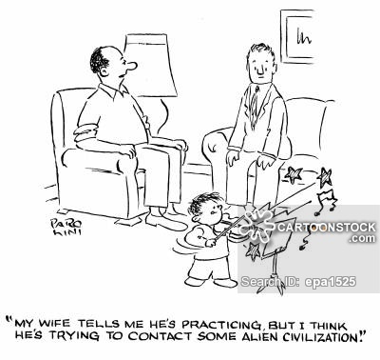
10 practice tips
4. Involve your parents!
They can clap the beat or be the “bouncy ball”
Give a performance at the end of a practice session.
Even non-musical parents can help!

Slide 11
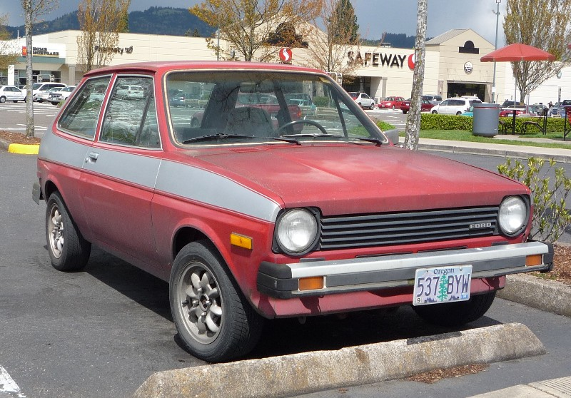
10 practice tips
3. Obtain and maintain the best instrument you can.
Do you know the difference between a Cadillac and a Ford Fiesta.

Slide 12
10 practice tips
2. Practice with the recording!
Listen to the recording
Count/finger along
Play along with the accompaniment only if possible.
Use your DVD included with your Essential Elements book
Create an EEi (Essential Elements Interactive) account online
Visit http://www.halleonard.com/EE2000AccompBW.jsp?subsiteid=6
(tracks 59-end only)
This is on the Mrs. Schack’s Weebly page under the 6th grade tab.
www.schackattack.weebly.com

Slide 13
10 practice tips
1. Record yourself!
Use an iPod, iPad, phone, video camera, etc.
Doesn’t have to be professional quality.
Play it back and follow your counting, notes, etc.
Does it sound like it should, if you know the song?
Create a portfolio of your practice.

Slide 14
RMS Practice requirements
Beginning Band:
1st semester: 60 minutes total – 4 days/week
Intermediate Band
1st semester: 80 minutes total – 4 days/week
Advanced Band
1st semester: 100 minutes total – 4-5 days/week
Formative assignment. Practice cards are due each Monday. Signed.

Slide 15
