Slide 1
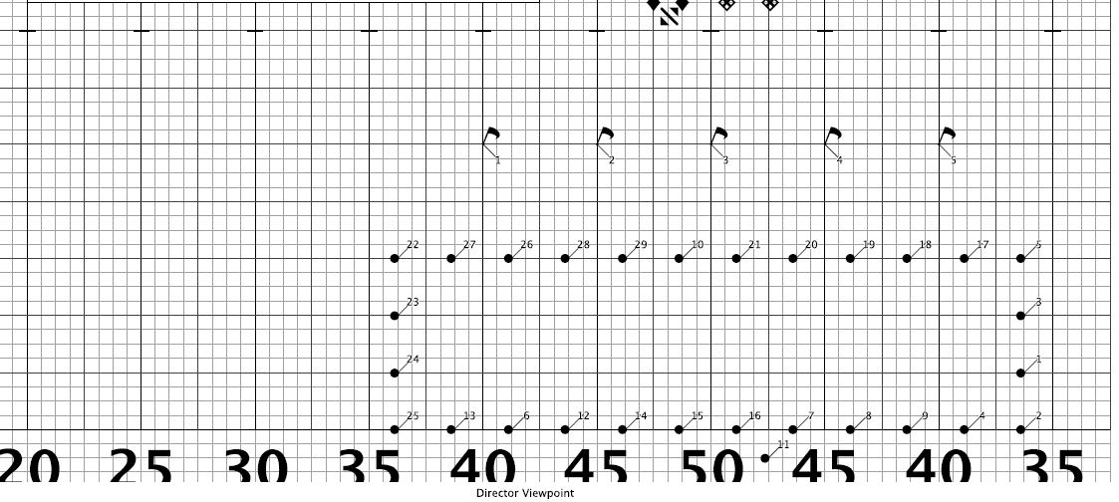
HOW TO READ YOUR COORDINATE SHEETS
Richmond Marching Band
Updated 2015

Slide 2
This is what everyone will receive…the coordinate sheet
Your Drill/Dot Number
Set #
Home Hash = Front Hash on by home sideline
# of counts in this set (not always the counts in the move)
How many steps 8 to 5!!!!!
frnt = toward front sideline behind = toward back sideline
Side of field to the audience
How many steps 8 to 5!!!!!
Outside = toward end zone Inside = toward 50

Slide 3
This is what the section leaders will receive (or you can download off the weebly page)
Title of the music selection
Measures numbers in the music
Pages & Sets are interchangeable words
They typically mean the same thing
Important information section leaders MUST share on how to march, counting, special instructions, etc

Slide 4
Let’s put it all together!
Total 32 counts in the move.
Divided up in two 16 count blocks.
Write in your music!!!
Measures 36, 37, 38, & 39 move 16.
Measures 40, 41, 42, & 43 hold 16.

Slide 5
If everyone marks their music, steps off their spots correctly, and stands evenly spaced we will have a successful marching band camp and season!

