Slide 2
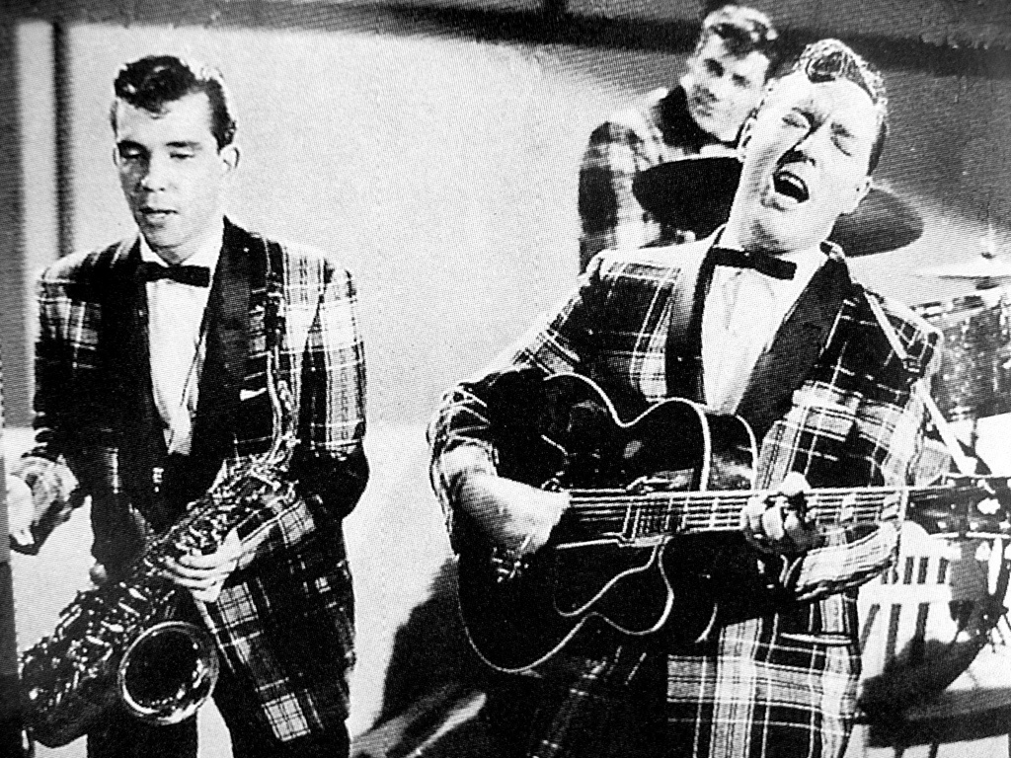
In 1954 a band emerged called
“Bill Haley and the ______ ”
Comets
They released a song called:
R___ A_____ T__ C____
Rock Around The Clock

Slide 3
Rock and Roll music didn’t exist at all until the...... 19 __s
1950’s

Slide 4
By 1956 Bill Haley had other hit records including:
See you ____ _______
later alligator
Shake, _____ ___ ____
Rattle and Roll
Dazzle
Razzle ______

Slide 5
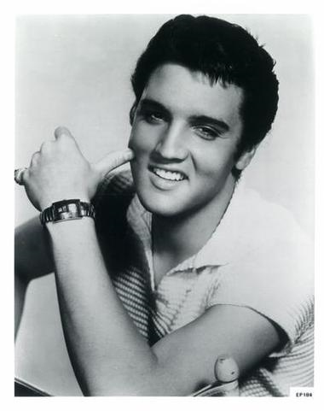
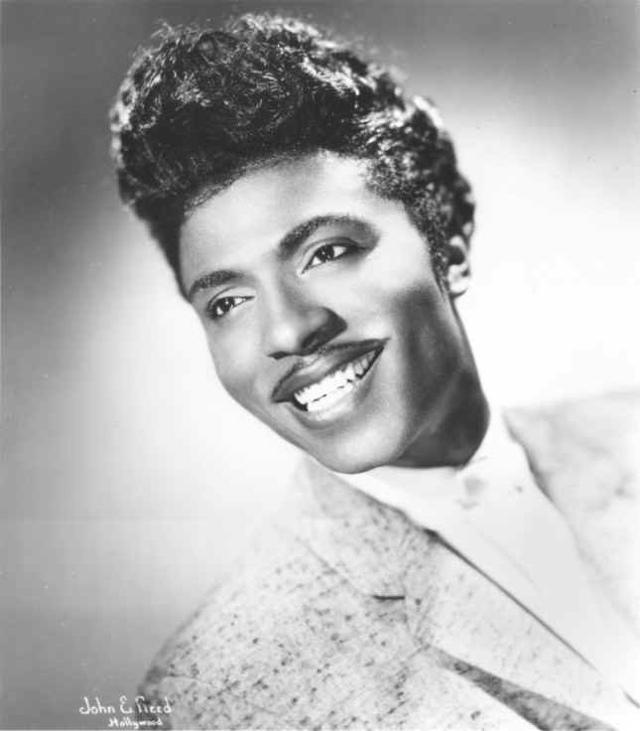
By 1957 Other “crazier and wilder” acts started to appear such as:
Elvis ________
Little ________
Presley
Richard

Slide 6
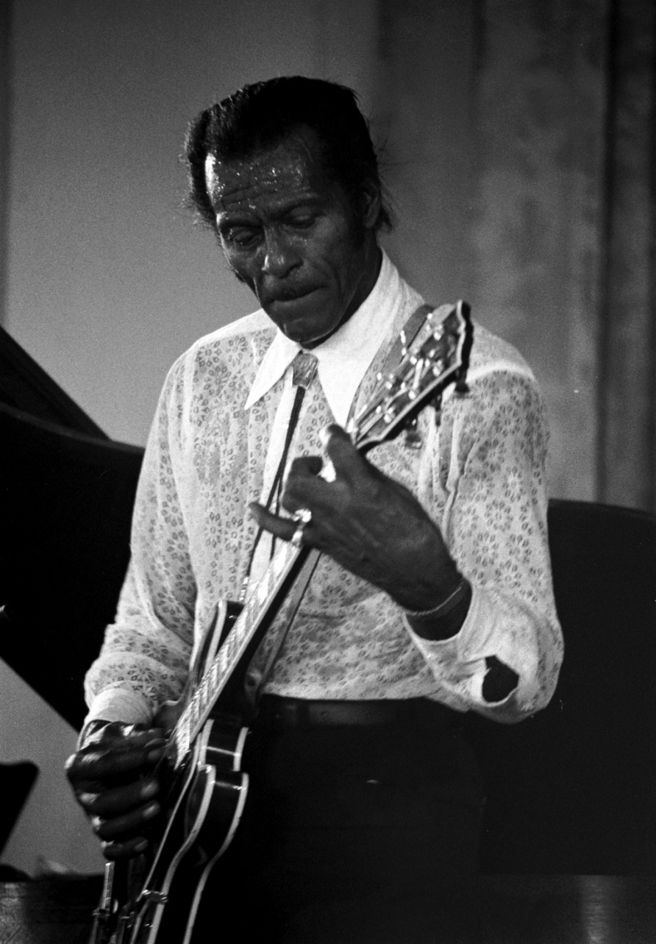
Introducing Rock Music to the black American population around this time was guitarist Chuck ______
Berry
His hits included:
Johnny __ ______
Rock ___ ____ ______
B Goode
and Roll Music

Slide 8
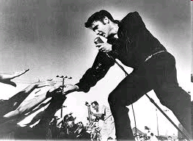
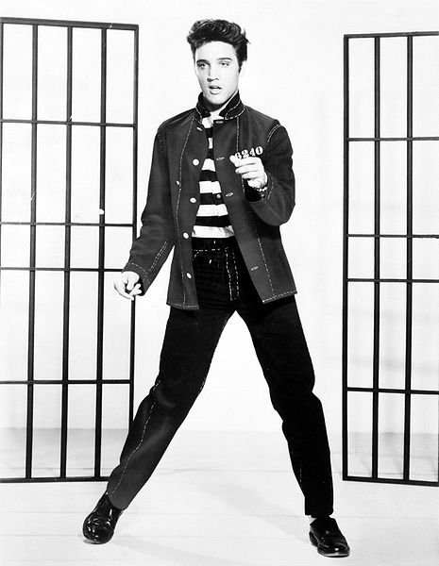
The artist generally known as the “King of Rock and Roll” was:

Slide 9
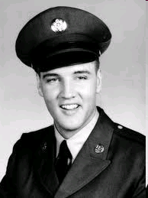
Discovered in 1954, Elvis became a national star by 1956-1957.
Elvis served in the _______
from 1958-1960
US army

Slide 10
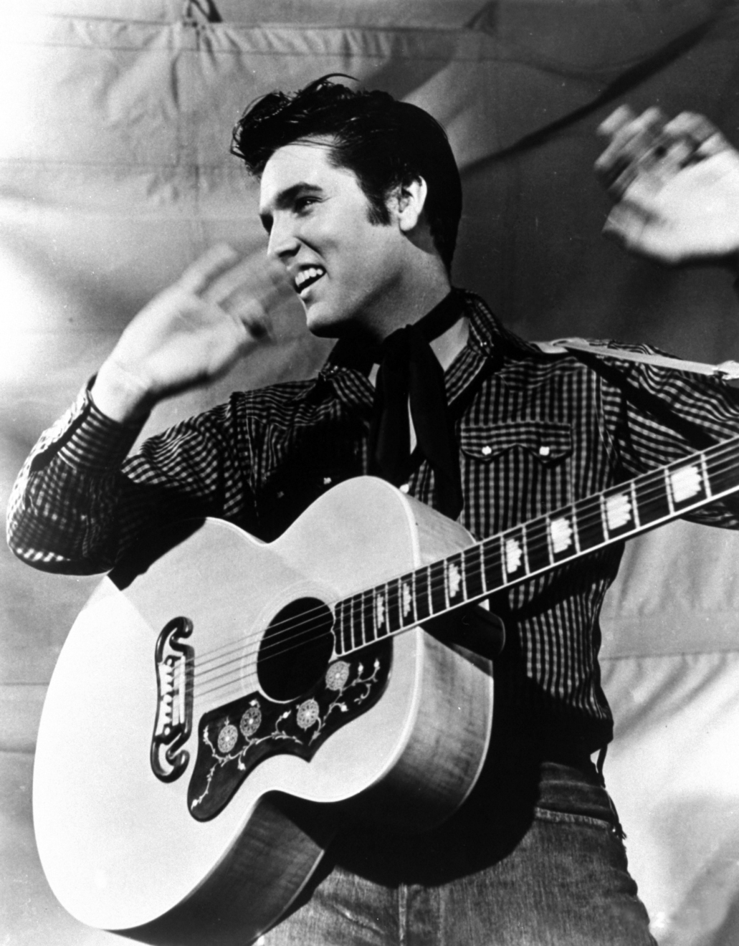
Elvis’s Hit Songs included:
Blue Suede Shoes
B______ S_______ S________
H____ D__
Hound Dog
L___ M_ T______
Love Me Tender
J_______ R____
Jailhouse Rock
Return to Sender
R____ t_ S_____
S________ M____
Suspicious Minds

Slide 11
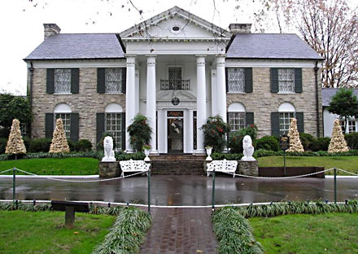
Elvis died from a drug overdose in ______
1977.
Even today people still visit his former home called “G_______”
“Graceland.”

Slide 12
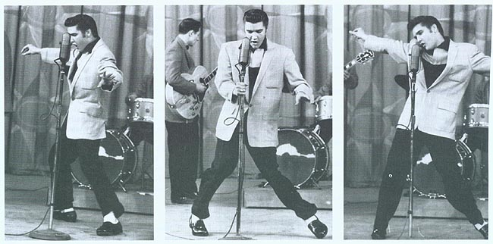
Trivia
Television stations were only allowed to film Elvis ......
from the waist up!
This was because of the way he moved his hips when he danced, which was considered too suggestive for his day.

Slide 14
In what year did three great American Rock and Roll stars die in a
light plane crash?
1959
They were:
Buddy Holly
B____ H____
T__ B__ B______
The Big Bopper
R____ V____
Richie Valens

Slide 15
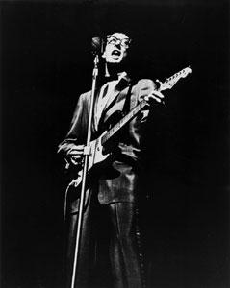
Buddy Holly
Is credited as being responsible for.....
Standardizing the line up of two guitars, bass and drums
Was a major influence on later artists such as:
The Beatles
The Beach Boys
The Rolling Stones
Bob Dylan

Slide 16
Buddy Holly
Hits Included:
P____ S__
Peggy Sue
T____ b_ t__ D__
That’ll be the Day

Slide 17
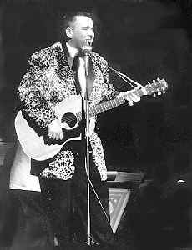
The Big Bopper (Jiles Richardson)
Was an early rock and roll disc jockey, but was turned into a pop star thanks to his one big hit:
C______ L___
Chantilly Lace

Slide 18
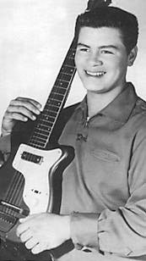
Richie Valens
Was just ____ years
old at the time of the crash
_17_
Big Hits included:
L_ B_____
La Bamba
Donna
D_____

Slide 19
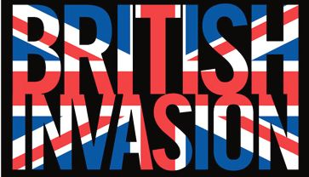

Slide 20
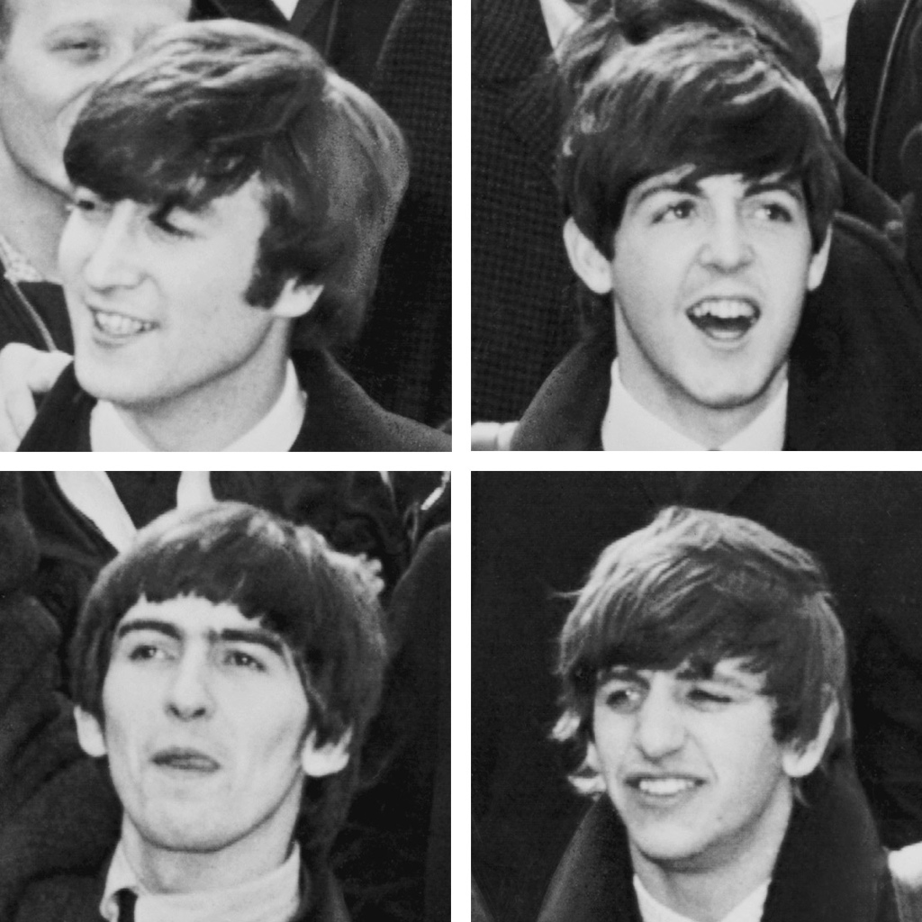
The Beatles
emerged around 1960 in:
L_______, UK
Liverpool, UK
Made their American Debut in 1964 on the:
E_ S______ S___
Ed Sullivan Show

Slide 21
The Beatles
Hits Included:
I W____ H___ Y___ H___
I Wanna Hold Your Hand
I Saw Her Standing There
I S___ H__ S_______ T____
A Hard Days Night
A H___ D___ N___
Y____ S_________
Yellow Submarine
L__ i_ B_
Let it Be
L___ in t__ S__w___ D________
Lucy in the Sky with Diamonds

Slide 22
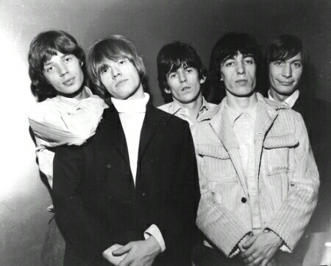
The Rolling Stones
Hits Include:
(I C___ g__ n_) S_________
(I Can’t get no) Satisfaction
J______ J___ F____
Jumpin’ Jack Flash
S___ M_ U_
Start Me Up

Slide 23
Other “British Invasion” Bands
Unscramble These Band Names:
The NALMIAS
The ANIMALS
The LILEOHS
The HOLLIES
The GORTGS
The TROGGS
The SKNIK
The KINKS

Slide 24
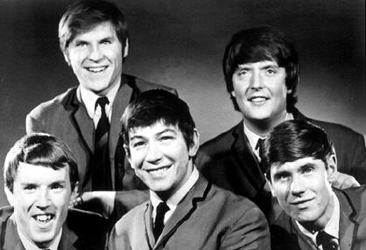
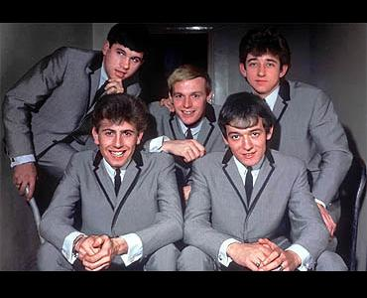
British Rock Bands
The Animals
The Hollies

Slide 25
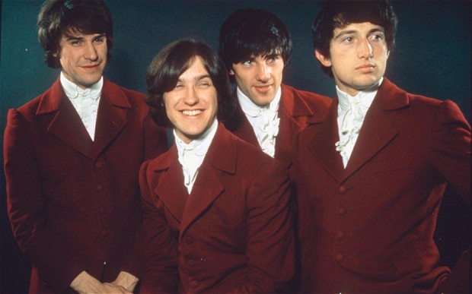
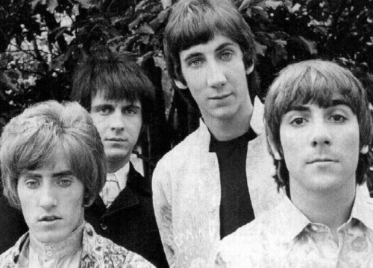
British Rock Bands
The Kinks
The Who

Slide 26
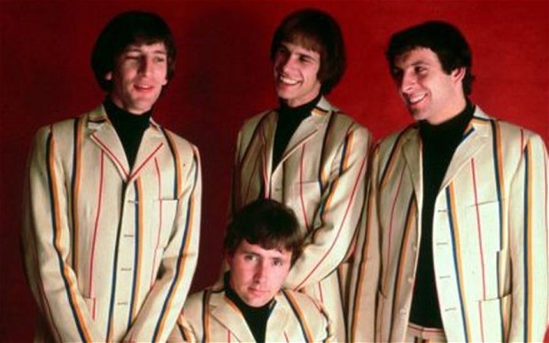
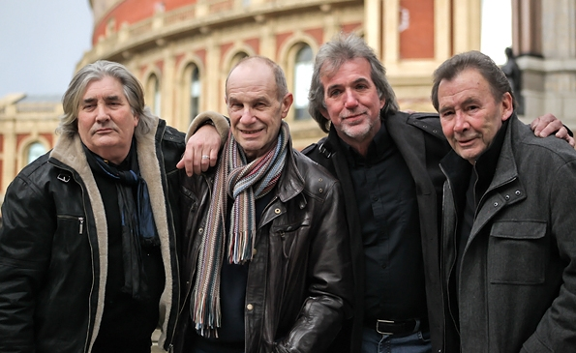
British Rock Bands
The Troggs

Slide 27
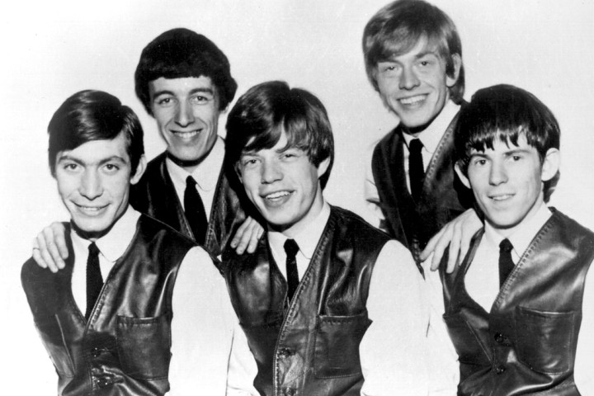
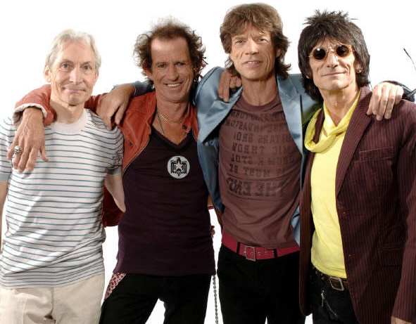
British Rock Bands
The Rolling Stones

Slide 29
Influences
Influence of African culture from thousands of black African slaves brought into America.
Combined Jazz and Gospel Music
This music evolved into these music genres:
S___
Soul
Rhythm and Blues
R____ and B___
Gospel
G____
H__-H__
Hip-Hop

Slide 30
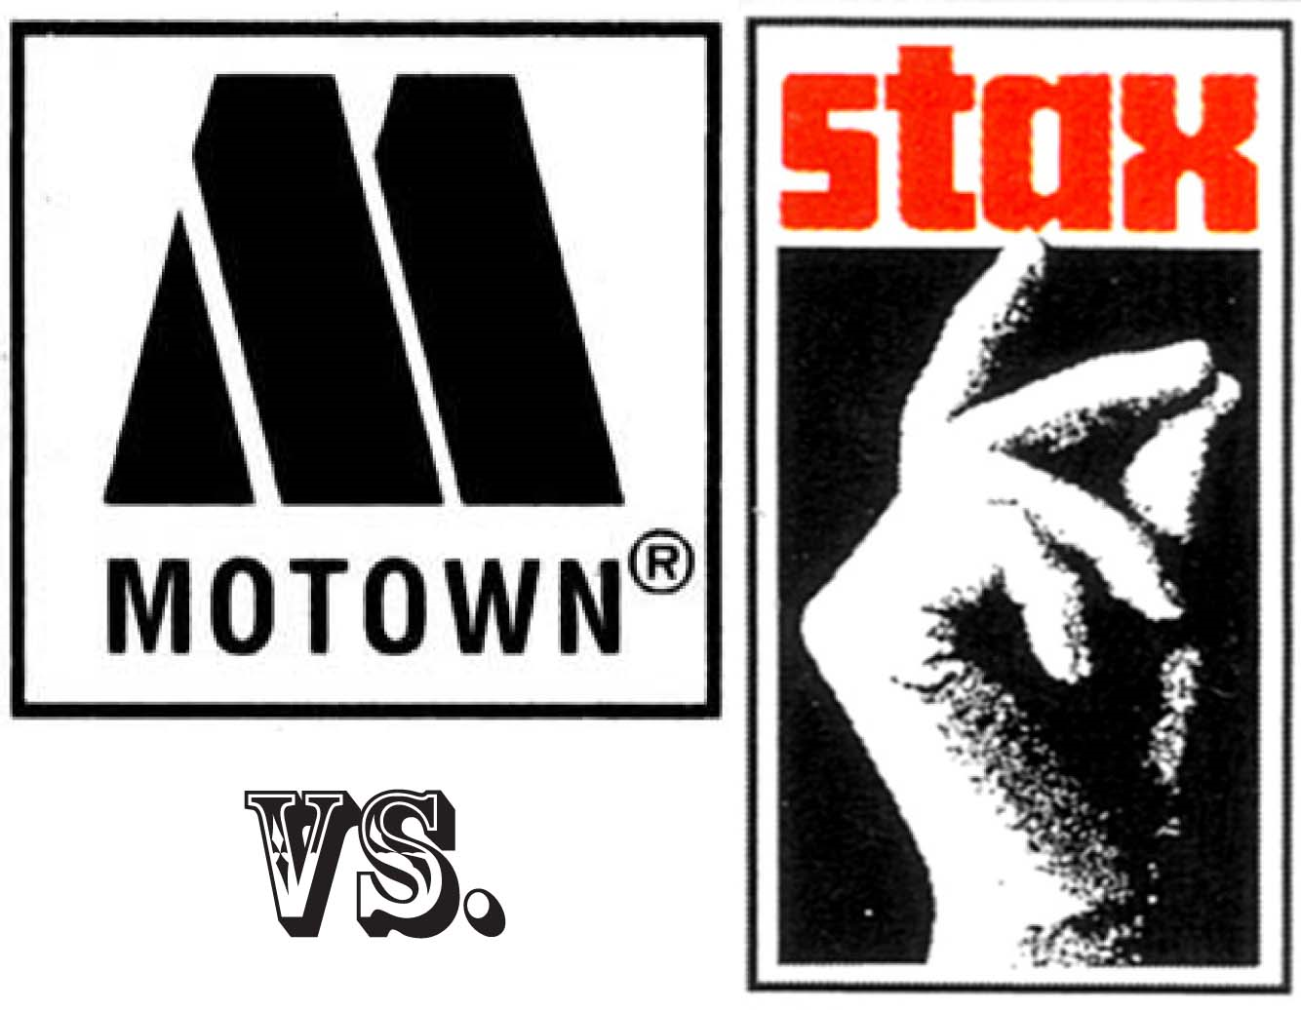
Soul Music is Defined by two record labels
“Motown” Records
“Stax” Records

Slide 31
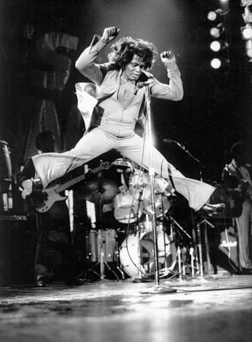
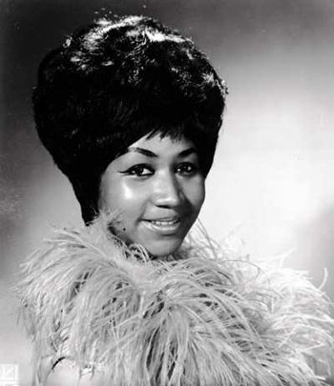
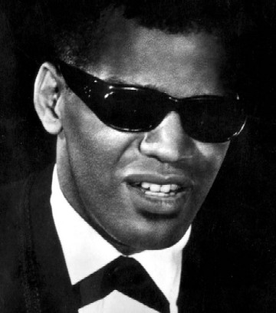
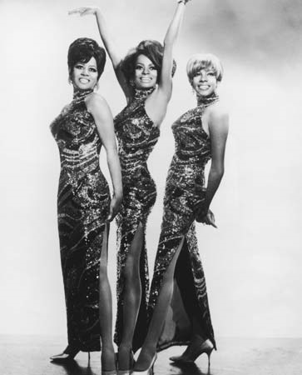
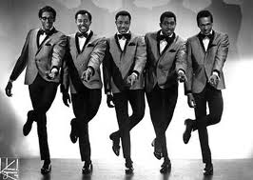
Prominent Soul Artists
Aretha Franklin
A____ F_____
James Brown
J___ B_____
Ray Charles
R__ C______
The Supremes
The S________
The Temptations
The T_________

Slide 32
Famous Soul Songs
James Brown
I Feel Good
I F___ G___
Aretha Franklin
Respect
R______
Wilson Pickett
In the M______ H___
In the Midnight Hour
Otis Redding
Sittin on the dock of the bay
Sittin on t__ d___ of t__ b__

Slide 34
There were three types of “surf music”
Instrumental
Smooth Vocal
Surf Rock

Slide 35
Instrumental Surf Music
Lead and Rhythm Guitar, Bass and Drums
Use of Whammy Bar and Reverb effects
W _ _ _ _ _ _
W I P E O U T
Best known example of this type of music:
by the “Surfaris”

Slide 36
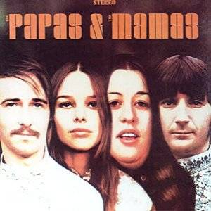
Vocal Surf Music
Extensive use of three part vocal harmony
Lyrics usually about cars, racing, surfing, anything related to the beach or ocean
Often Slow Ballads
Example by the
“Mamas and the Papas”:
California Dreaming
C______ D_______

Slide 37
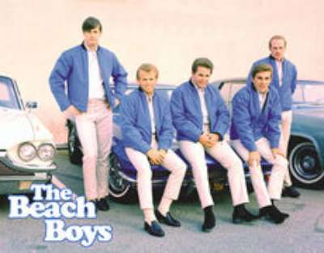
Surf Rock Music
Exemplified by the Beach Boys
Clean Style - no distortion in guitars
Smooth, easy going surf style

Slide 38
Famous Surf Era Songs
The Beach Boys
Surfin’ USA
S_____ _ _ _
G___ V________
Good Vibrations

Slide 40
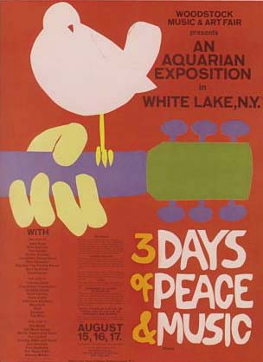
“Woodstock” Music Festival

Slide 41
“Woodstock” Music Festival
Held on a dairy farm in rural New York State in
19__
1969
How many people turned up?
between 400-500 thousand people
(half did not have a ticket)

Slide 42
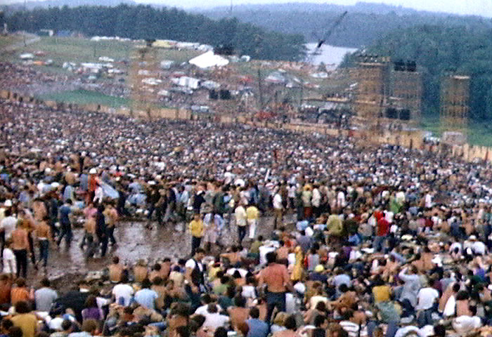
Imagine what it would have been like....

Slide 43
Performers at Woodstock included
Folk musicians such as:
Crosby, Stills, Nash and Young
Joan Baez
“Acid” or “Psychedelic” Rock Groups
Jefferson Airplane
The Grateful Dead
The Who

Slide 44
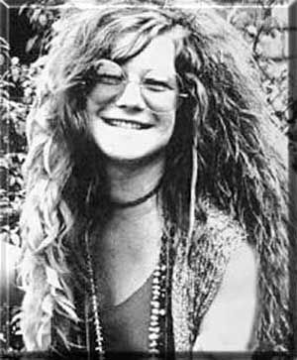
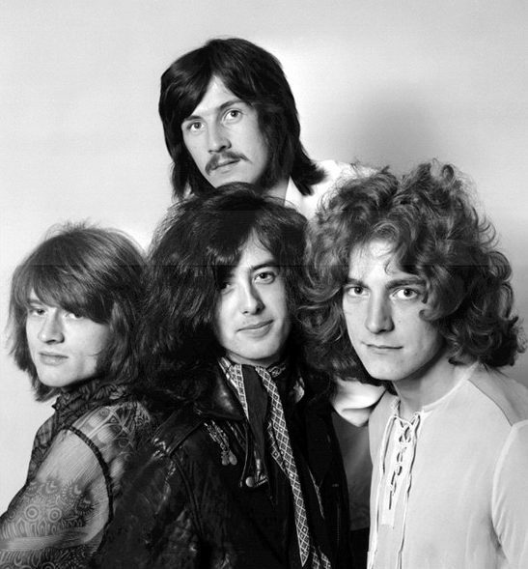
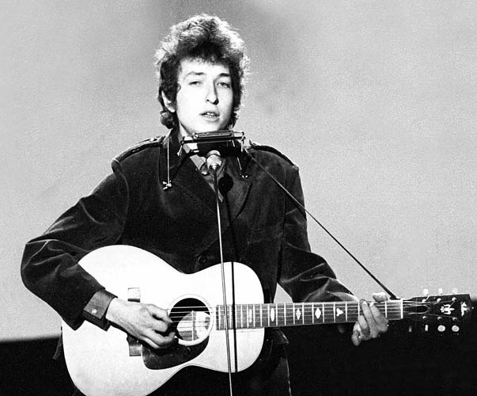
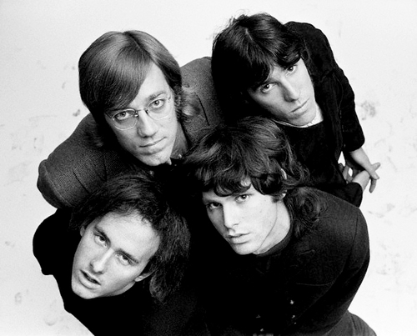
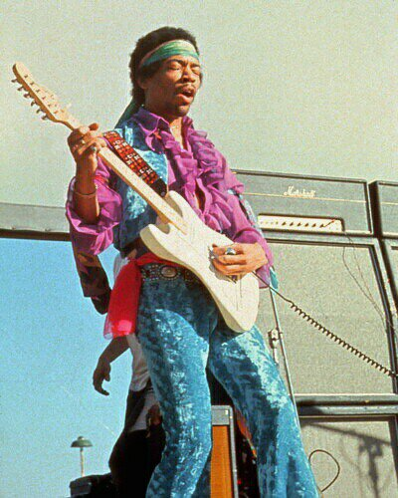
Popular Performers of the era
Bob Dylan
B__ D____
Jimi Hendrix
J___ H_____
Janis Joplin
J____ J_____
The Doors
The D_____
Led Zeppelin
L__ Z______

Slide 45
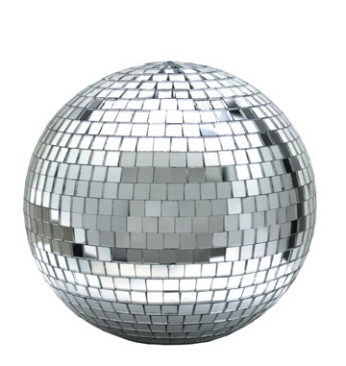

Slide 46
“Disco” is short for:
D__________
Discotheque
(the french word for ‘nightclub’)

Slide 47
Disco was most popular....
1970’s
From the early 19__
until the mid 19__
1980’s

Slide 48
Disco Music....
Influenced by F___ and S___ Music
Funk
Soul
May include different instrumentation
Percussion
Keyboards
Horns (Trumpets and Saxophones)
Orchestral Strings

Slide 49
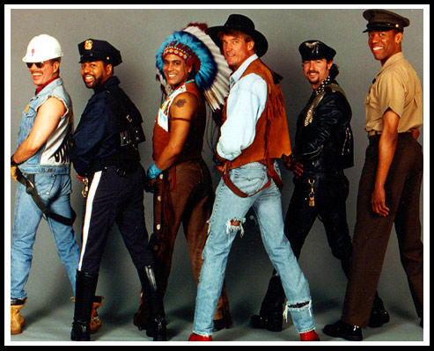
One of the best known disco groups was..
The Village People
The V_____ P_____

Slide 50
The Village People’s Hit Songs Include:
Y M C A
Y _ _ _
M_____ M__
Mancho Man
Go West
G_ W___
Can’t Stop The Music
C___ S__ T__ M____

Slide 51
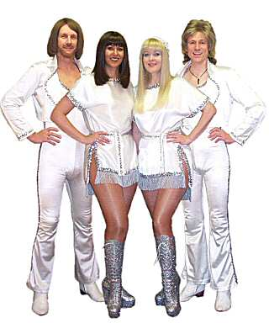
Another Famous Disco Group:
A B B A
_ _ _ _

Slide 52
Hit Songs for ABBA Include:
D_______ Q_____
Dancing Queen
W________
Waterloo
F________
Fernando
Mamma Mia
M_____ M__

Slide 53
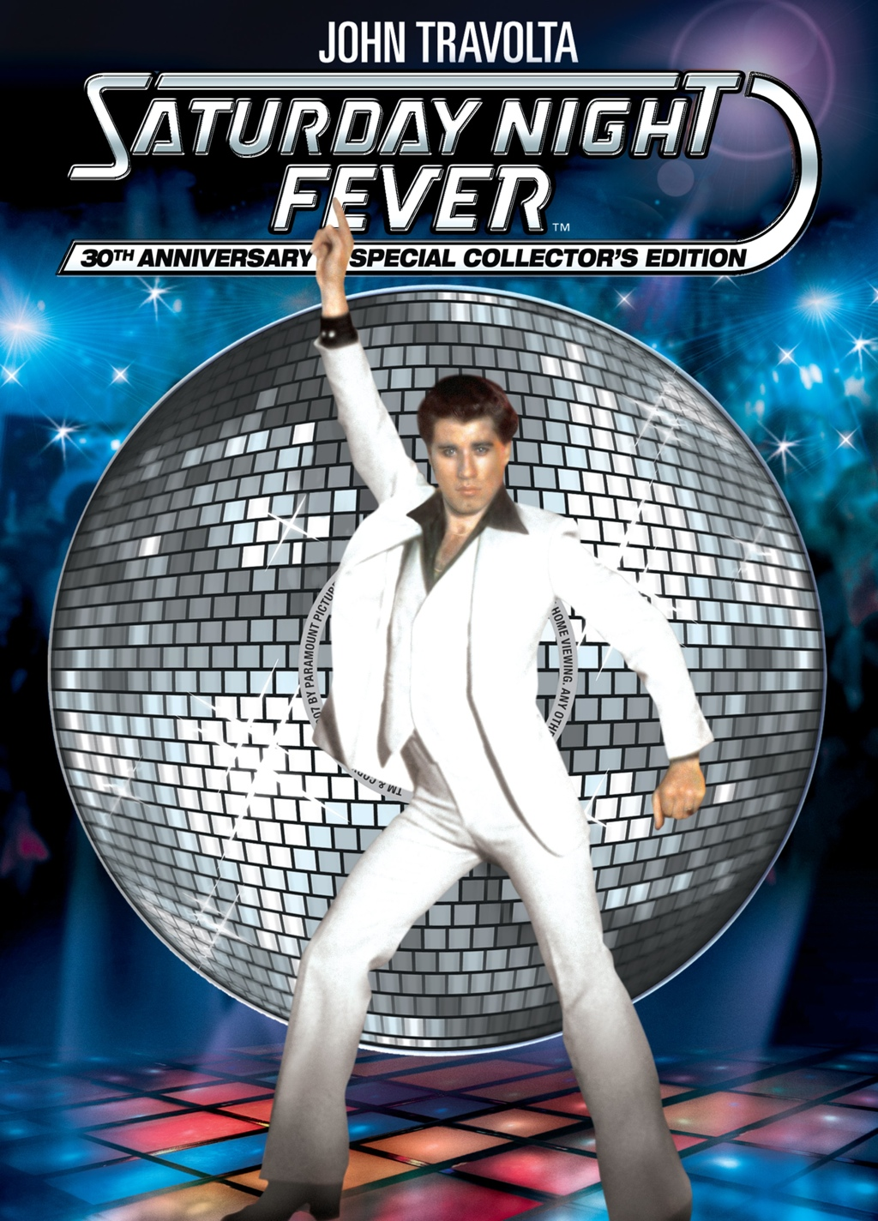
In 1977 when disco was at the height of its popularity a movie came out called...
Saturday Night Fever
S______ N____ F____
starring:
John Travolta
J___ T______

Slide 55
Classic Rock
Often refers to the hard rock style of the:
19__
1970’s

Slide 56
Popular 1970s Hard Rock Bands:
L__ Z______
Led Zeppelin
The Who
T__ W__
Deep Purple
D___ P_____

Slide 57
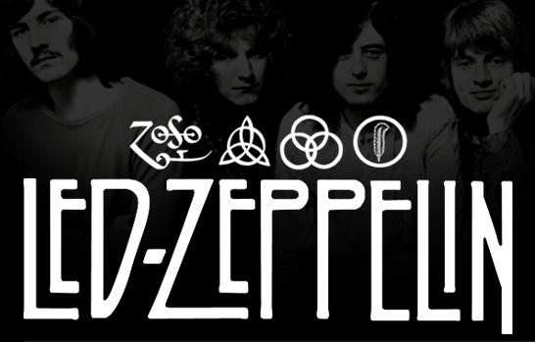
Led Zeppelin
famous songs include:
Whole Lotta Love
W____ L____ L___
B____ D__
Black Dog
S______ to H______
Stairway to Heaven

Slide 58
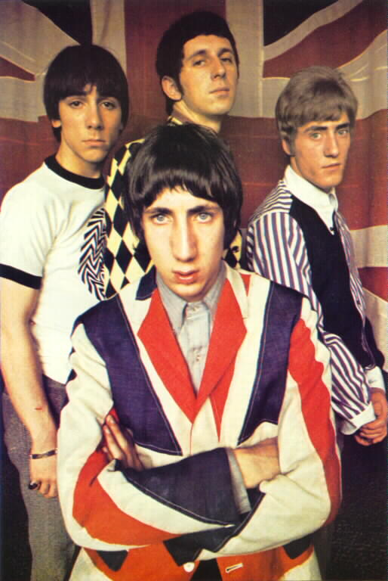
The Who
famous songs include:
My Generation
My G________
Who are you?
W__ a__ y__?

Slide 59
1980’s
“Hair” Bands and Hard Rock

Slide 60
Big Hair/Glam Rock Bands that were big in the 1980’s:
Motley Crue
M____ C___
P_____
Poison
Twisted Sister
T_____ S____
K___
KISS

Slide 61
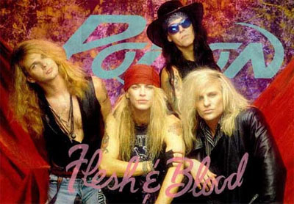
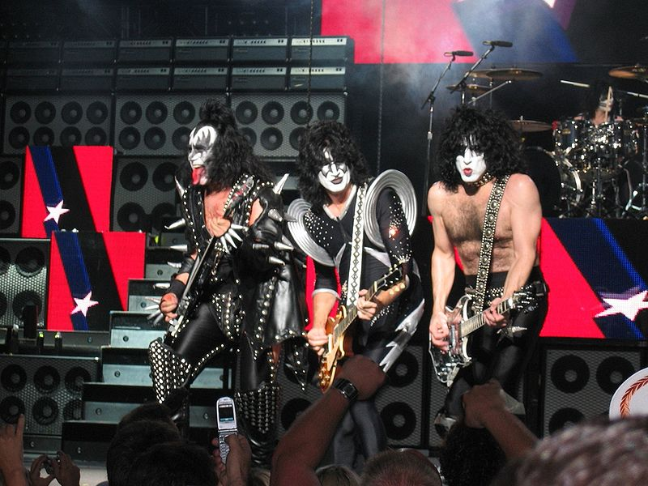
Poison
Kiss

Slide 62
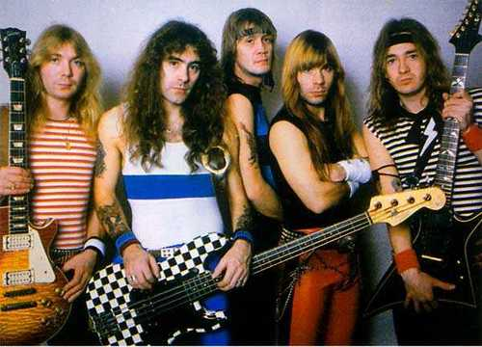
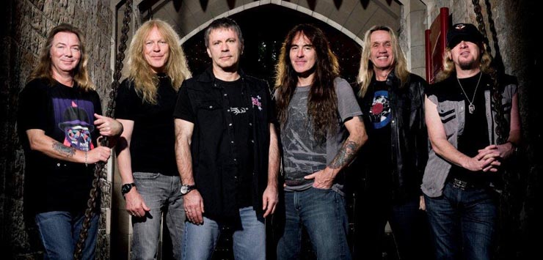
Heavy Metal Acts that were big in the 1980’s, and continue to today:
I___ M_____
Iron Maiden

Slide 63
J____ P____
Judas Priest

Slide 64
O____ O_______
Ozzy Ozbourne

Slide 65
Progressive Rock
Progressive Rock Artists Include:
Rush
R____
D____ T______
Dream Theatre
Genesis
G______
Pink Floyd
P___ F____

